Slide 1

School of Computing Science and Engineering
B.Tech 1st Year
Course Code : (BEE01T1004) Subject: Embedded Technology and IOT
IInd Sem
Topic :-
Logical Design Of IOT :-
Presented By :-AVIRAL GAURAV 21SCSE1300029
ABHINAV KUMAR CHOUDHARY 21SCSE1011615
Section :- 24 Submitted to :- Dr. USHA CHAUHAN
Program Name: B.Tech(CSE) CAT- III

Slide 2
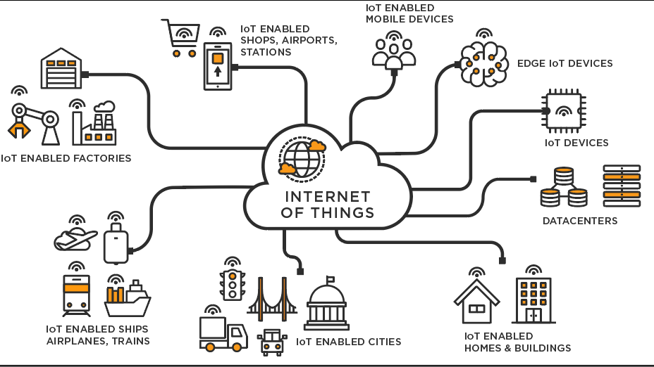
Contents
1. IoT Functional Blocks.
2. IoT Communication Block.
3. IoT Communication APIs
Program Name: B.Tech(CSE) CAT- III

Slide 3
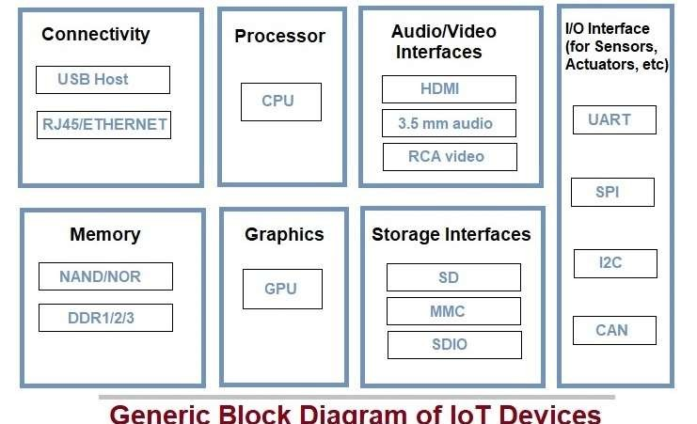
Generic Block Diagram of IoT :-
These Platform known as IoT Platform.
Program Name: B.Tech(CSE) CAT-III

Slide 4
IoT Functional blocks
An IoT system consists of a number of functional blocks like Devices, services, communication, security, and application that provide the capability for sensing, actuation, identification, communication, and management.
Program Name: B.Tech(CSE) CAT-III

Slide 5
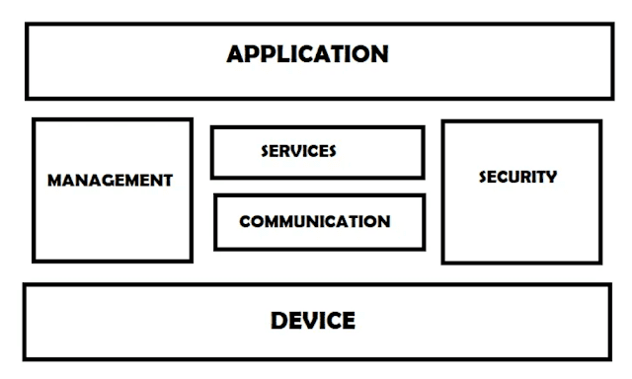

Slide 6
IoT Functional blocks
Application
It is an interface that provides a control system that use by users to view the status and analyze of system.
Management
This functional block provides various functions that are used to manage an IoT system.
Services
This functional block provides some services like monitoring and controlling a device and publishing and deleting the data and restoring the system.

Slide 7
IoT Functional blocks
Communication
This block handles the communication between the client and the cloud-based server and sends/receives the data using protocols.
Security
This block is used to secure an IoT system using some functions like authorization, data security, authentication, 2-step verification, etc.
Device
These devices are used to provide sensing and monitoring control functions that collect data from the outer environment.

Slide 8
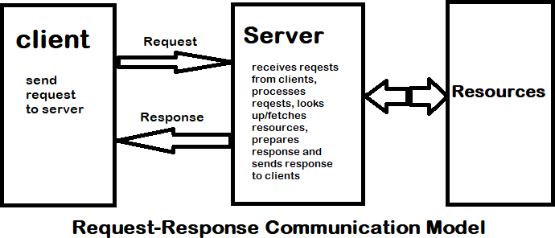
IoT Communication Model :-
Request-Response Model
Publish-Subscribe Model
Push-Pull Model
Exclusive Pair Model
Request-Response Model
Request-response is a stateless communication model and each request-response pair is of others.
Program Name: B.Tech(CSE) CAT-III

Slide 9
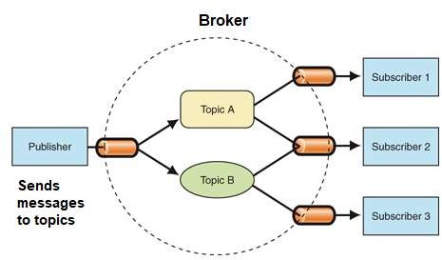
IoT Communication Model :-
Example: A client (browser) submits an HTTP request to the server; then the server returns a response to the client. The response contains status information about the request and may also contain the requested content.
Publish-Subscribe Model :-
Publish-Subscribe is a communication model
That involves publishers, brokers and consumers.
Publishers are the source of data.
Publishers send the data to the topics which
are managed by the broker.
Publishers are not aware of the consumers.
Consumers subscribe to the topics which are
managed by the broker.
When the broker receive data for a topic from the publisher, it sends the data to all the
subscribed consumers.
Program Name: B.Tech(CSE) CAT-III

Slide 10
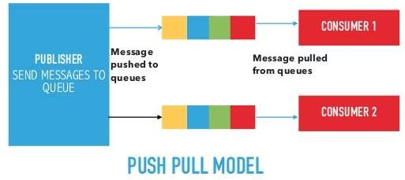
IoT Communication Model :-
Push-Pull Model :-
Push-Pull is a communication model in which the data producers push the data to queues and the consumers Pull the data from the Queues.
Producers do not need to be aware of the consumers.
Queues help in decoupling the messaging between the Producers and Consumers..
Queues also act as a buffer which helps in situations when there is a mismatch between the rate at which the producers push data and the rate at which the consumer pull data.
Program Name: B.Tech(CSE) CAT-III

Slide 11
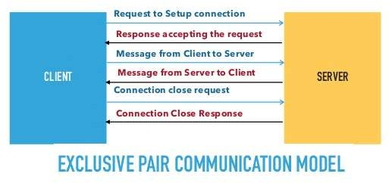
IoT Communication Model :-
Exclusive Pair Model :-
Exclusive Pair is a bidirectional, fully duplex communication model that uses a persistent connection between the client and server.
Connection is setup it remains open until the client sends a request to close the connection.
Client and server can send messages to each other after connection setup.
Exclusive pair is stateful communication model and the server is aware of all the open connections.
Program Name: B.Tech(CSE) CAT-III

Slide 12
IoT Communication APIs
REST-based Communication APIs
WebSocket-based Communication APIs
REST-based Communication APIs
Representational state transfer (REST) is a set of architectural principles by which you can design Web services the Web APIs that focus on systems’s resources and how resource states are addressed and transferred.
REST APIs that follow the request response communication model, the rest architectural constraint apply to the components, connector and data elements, within a distributed hypermedia system.
A RESTful web service is a ” Web API ” implemented using HTTP and REST principles.
REST is most popular IoT Communication APIs.
Program Name: B.Tech(CSE) CAT - III

Slide 13
IoT Communication APIs
REST-based Communication APIs.
The rest architectural constraint are as follows:
Client-server
Stateless
Cache-able
Layered system
Uniform interface
Code on demand
Client-server
The principle behind the client-server constraint is the separation of concerns.
Clients should not be concerned with the storage of data which is concern of the server.
Similarly the server should not be concerned about the user interface, which is concern of the client.
Separation allows client and server to be independently developed and updated.
Program Name: B.Tech(CSE) CAT - III

Slide 14
IoT Communication APIs
Stateless
Each request from client to server must contain all the information necessary to understand the request, and cannot take advantage of any stored context on the server.
The session state is kept entirely on the client.
Cache-able
Cache constraints requires that the data within a response to a request be implicitly or explicitly leveled as cache-able or non cache-able.
If a response is cache-able, then a client cache is given the right to reuse that response data for later, equivalent requests. caching can partially or completely eliminate some instructions and improve efficiency and scalability.
Program Name: B.Tech(CSE) CAT - III

Slide 15
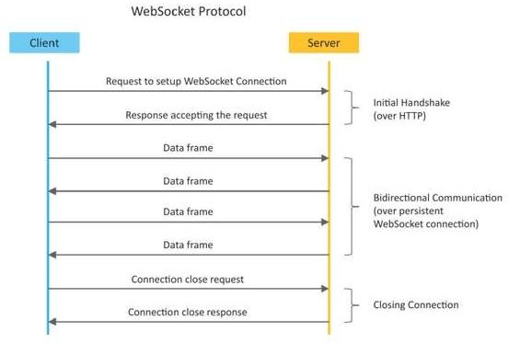
IoT Communication APIs
WebSocket-based Communication APIs :-
Program Name: B.Tech(CSE) CAT - III

Slide 16
IoT Communication APIs
WebSocket-based Communication APIs
Websocket APIs allow bi-directional, full duplex communication between clients and servers.
Websocket APIs follow the exclusive pair communication model.
Unlike request-response model such as REST, the WebSocket APIs allow full duplex communication and do not require new connection to be setup for each message to be sent.
Websocket communication begins with a connection setup request sent by the client to the server.
The request (called websocket handshake) is sent over HTTP and the server interprets it is an upgrade request.
If the server supports websocket protocol, the server responds to the websocket handshake response.
Program Name: B.Tech(CSE) CAT - III

Slide 17
IoT Communication APIs
WebSocket-based Communication APIs
After the connection setup client and server can send data/mesages to each other in full duplex mode.
Websocket API reduce the network traffic and latency as there is no overhead for connection setup and termination requests for each message.
Websocket suitable for IoT applications that have low latency or high throughput requirements.
So Web socket is most suitable IoT Communication APIs for IoT System.
Program Name: B.Tech(CSE) CAT - III

Slide 18
Thank you!

